Slide 1

Blockchain
Sunitha R
Department of Computer Science and Engineering

Slide 2

Blockchain
BLOCKCHAIN NETWORK ATTACKS
Sunitha R
Department of Computer Science and Engineering

Slide 3
Blockchain
BLOCKCHAIN ATTACKS
A blockchain network includes nodes that create and run transactions and provide other services.
For instance, the Bitcoin network is formed by nodes that send and receive transactions and miners that add approved transactions to blocks.
Cybercriminals look for network vulnerabilities and exploit them with the following types of attacks.

Slide 4
Blockchain
BLOCKCHAIN ATTACK SURFACE
Blockchain Network
User wallets
Smart Contract
Transaction Verification Mechanism
Mining pool

Slide 5
Blockchain
Cybersecurity Threats and Incidents on Blockchain Network
Identified 65 real-world cybersecurity incidents occurred between 2011 and first half-year 2019 that have adversely impacted blockchain systems.
The blockchain cybersecurity vulnerabilities are divided into five categories
Clients’ Vulnerabilities
Consensus Mechanisms Vulnerabilities
Mining Pool Vulnerabilities
Network Vulnerabilities
Smart Contract Vulnerabilities

Slide 6
Blockchain
ATTACKS ON BLOCKCHAIN
Distributed denial of service
Transaction malleability attacks
Time jacking
Routing attacks
Sybil attacks
Eclipse attacks
Long range attacks on proof of stake networks

Slide 7
Blockchain
DISTRIBUTED DENIAL OF SERVICE
Distributed denial of service (DDoS) attacks are hard to execute on a blockchain network, but they’re possible.
When attacking a blockchain network using DDoS, hackers intend to bring down a server by consuming all its processing resources with numerous requests.
DDoS attackers aim to disconnect a network’s mining pools, e-wallets, crypto exchanges, and other financial services.
A blockchain can also be hacked with DDoS at its application layer using DDoS botnets.
In 2017, Bitfinex suffered from a massive DDoS attack. It was especially inconvenient for the IOTA Foundation, which had launched their IOTA token on the platform the day before Bitfinex informed users about the attack.
Three years later, in February 2020, Bitfinex experienced another DDoS attack just a day after the OKEx cryptocurrency exchange noticed a similar attack.

Slide 8
Blockchain
DISTRIBUTED DENIAL OF SERVICE

Slide 9
Blockchain
TRANSACTION MALLEABILITY ATTACKS
A transaction malleability attack is intended to trick the victim into paying twice. In the Bitcoin network, every transaction has a hash that’s a transaction ID.
If attackers manage to alter a transaction’s ID, they can try to broadcast the transaction with a changed hash to the network and have it confirmed before the original transaction.
If this succeeds, the sender will believe the initial transaction has failed, while the funds will still be withdrawn from the sender’s account.
If the sender repeats the transaction, the same amount will be debited twice. This hack is successful once the two transactions are confirmed by miners.
Mt. Gox, a Bitcoin exchange, went bankrupt as the result of a malleability attack in 2014.
However, Bitcoin seems to have solved this issue by introducing the Segregated Witness (SegWit) process, which separates signature data from Bitcoin transactions and replaces it with a non-malleable hash commitment to each signature.

Slide 10
Blockchain
TIME JACKING
Time jacking exploits a theoretical vulnerability in Bitcoin timestamp handling.
During a time jacking attack, a hacker alters the network time counter of the node and forces the node to accept an alternative blockchain.
This can be achieved when a malicious user adds multiple fake peers to the network with inaccurate timestamps.
However, a time jacking attack can be prevented by restricting acceptance time ranges or using the node’s system time.

Slide 11
Blockchain
ROUTING ATTACKS
A routing attack can impact both individual nodes and the whole network.
The idea of this hack is to tamper with transactions before pushing them to peers.
It’s nearly impossible for other nodes to detect this tampering, as the hacker divides the network into partitions that are unable to communicate with each other.
Routing attacks consist of two separate attacks:
A partition attack, which divides the network nodes into separate groups
A delay attack, which tampers with propagating messages and sends them to the network.

Slide 12
Blockchain
SYBIL ATTACKS
A Sybil attack is arranged by assigning several identifiers to the same node. Blockchain networks have no trusted nodes, and every request is sent to several nodes.
During a Sybil attack, a hacker takes control of multiple nodes in the network. Then the victim is surrounded by fake nodes that close up all their transactions.
Finally, the victim becomes open to double-spending attacks.
A Sybil attack is quite difficult to detect and prevent, but the following measures can be effective: increasing the cost of creating a new identity, requiring some type of trust for joining the network, or determining user power based on reputation.

Slide 13
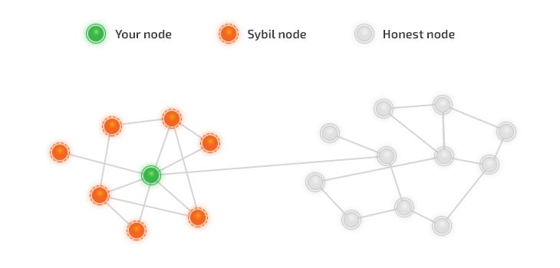
Blockchain
SYBIL ATTACKS

Slide 14
Blockchain
ECLIPSE ATTACKS
An eclipse attack requires a hacker to control a large number of IP addresses or to have a distributed botnet.
Then the attacker overwrites the addresses in the “tried” table of the victim node and waits until the victim node is restarted.
After restarting, all outgoing connections of the victim node will be redirected to the IP addresses controlled by the attacker.
This makes the victim unable to obtain transactions they’re interested in.
Researchers from Boston University initiated an eclipse attack on the Ethereum network and managed to do it using just one or two machines.

Slide 15
Blockchain
LONG RANGE ATTACKS ON PROOF OF STAKE NETWORKS
Long range attacks target networks that use the proof of stake (PoS) consensus algorithm, in which users can mine or validate block transactions according to how many coins they hold.
These attacks can be categorized into three types:
Simple - A naive implementation of the proof of stake protocol, when nodes don’t check block timestamps
Posterior corruption - An attempt to mint more blocks than the main chain in a given time frame
Stake bleeding - Copying a transaction from the honestly maintained blockchain to a private blockchain maintained by the attacker
When conducting a long-range attack, a hacker uses a purchased or stolen private key of a sizable token balance that has already been used for validating in the past. Then, the hacker can generate an alternative history of the blockchain and increase rewards based on PoS validation.

Slide 16
Blockchain
USER WALLET ATTACKS
User wallet credentials are the main target for cybercriminals.
Phishing
Dictionary attacks
Vulnerable signatures
Flawed key generation

Slide 17
Blockchain
Supplementary readings
https://arxiv.org/pdf/1904.03487.pdf
https://link.springer.com/chapter/10.1007/978-981-15-1518-7_5
https://repository.stcloudstate.edu/cgi/viewcontent.cgi?article=1093&context=msia_
https://www.researchgate.net/publication/331806569_Overview_of_Attack_Surfaces_in_Blockchain

Slide 18
THANK YOU
Prof.Sunitha R
Department of Computer Science and Engineering
sunithar@pes.edu

